Slide 1
IBM University Engagement Project Submission
“Exploring the Power of Agentic AI with IBM Granite and LangFlow”

Slide 2

Project Tile – AI-Powered Career & Skill-Gap Advisor for Tier-2/3 College Students
Domain of Project – Education
Student Name | Recent Passport Photo | Email ID | Mobile number [WhatsApp]
LAKSHITHA R |  | rlakshitha312@gmail.com | 8072564298

Slide 3
Problem Statement -
The Challenge Students at tier-2/3 colleges often lack access to personalized career counseling. Placement cells are overloaded, industry skill requirements change fast, and students rely on scattered, generic advice from forums or seniors — leading to mismatched career choices and skill gaps at hiring time.
The Objective Build an AI-powered Career & Skill-Gap Advisor that gives students personalized, data-backed career guidance. It should:
Resume/Skill Analysis – Parse a student's resume/skills and compare against real job-role requirements
Skill-Gap Retrieval (RAG) – Fetch current industry skill benchmarks and certification requirements from trusted sources
Learning Path Recommendation – Suggest specific courses/certifications to close identified gaps
Mock Interview & Feedback – Simulate role-specific interviews and give structured feedback
Multi-Agent System:
Skill Assessment Agent (parses resume, identifies gaps)
Career Path Agent (recommends roles based on interests + aptitude)
Learning Resource Agent (suggests courses/certifications via RAG)
Interview Coach Agent (mock interviews + feedback)
Dashboard – Visual skill-gap radar, progress tracker, readiness score

Slide 4
Proposed Solution -
The proposed solution is a multi-agent AI Career Advisor built using LangFlow, IBM watsonx.ai, and Granite Models, giving students personalized, real-time career and skill guidance. It tackles the gap between overloaded campus placement cells and the need for individualized counseling through a modular, intelligent architecture.
At its core, a Retrieval-Augmented Generation (RAG) pipeline pulls current job-role requirements and skill taxonomies from sources like LinkedIn job postings, NASSCOM skill frameworks, and course catalogs (Coursera, NPTEL). This data is embedded into a vector database so Granite models can retrieve and reason over up-to-date, role-specific requirements instead of static/generic advice.
Four agents work together: the Skill Assessment Agent parses a student's resume and identifies gaps against target roles; the Career Path Agent recommends suitable roles based on interests, academic background, and aptitude; the Learning Resource Agent retrieves and ranks relevant courses/certifications to close those gaps; and the Interview Coach Agent runs role-specific mock interviews and gives structured, actionable feedback.
A Streamlit/React dashboard visualizes the student's skill-gap radar chart, tracks progress over time, and shows a "job-readiness score." LangFlow orchestrates the agent workflow; watsonx.ai handles scalable deployment, embeddings, and governance; Granite models power reasoning, summarization, and personalized feedback generation.
This delivers an end-to-end, always-available career mentor — reducing reliance on overstretched placement cells and helping students make informed, evidence-based career decisions.

Slide 5
Technology Used
LangFlow – Visual design/orchestration of the multi-agent workflow
IBM Granite model (e.g. granite-4.0-8b-instruct) – Natural language reasoning, resume parsing, personalized feedback
IBM Cloud – Infrastructure to build, deploy, and scale the advisor reliably and securely
RAG – Retrieves real, current job/skill data before generating advice, keeping recommendations trustworthy
IBM Watsonx.ai – Model deployment, embeddings, AI governance
Vector Database (FAISS/Chroma) – Stores embedded job-role and course-catalog data for retrieval

Slide 6
Langflow component Used -
Chat Input – Where students enter resume text, interests, or interview answers
IBM watsonx AI Agent – Processes input via Granite models to generate skill-gap analysis and career suggestions
Granite model – Granite-4.0-8B-Instruct → fast reasoning for real-time feedback
Chat Output – Displays skill-gap reports, recommended courses, interview feedback
File Component – Stores resumes, skill taxonomies, course catalog data for retrieval
(Optional) Vector Store component for FAISS/Chroma RAG retrieval

Slide 7
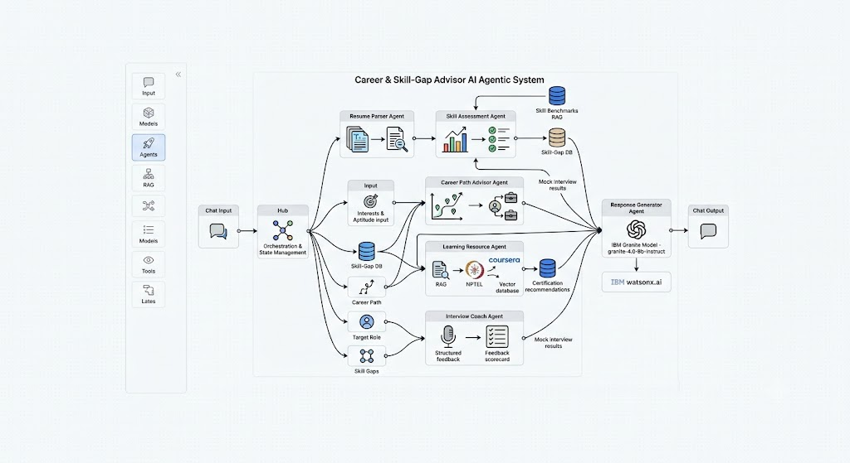
Langflow workflow -

Slide 8
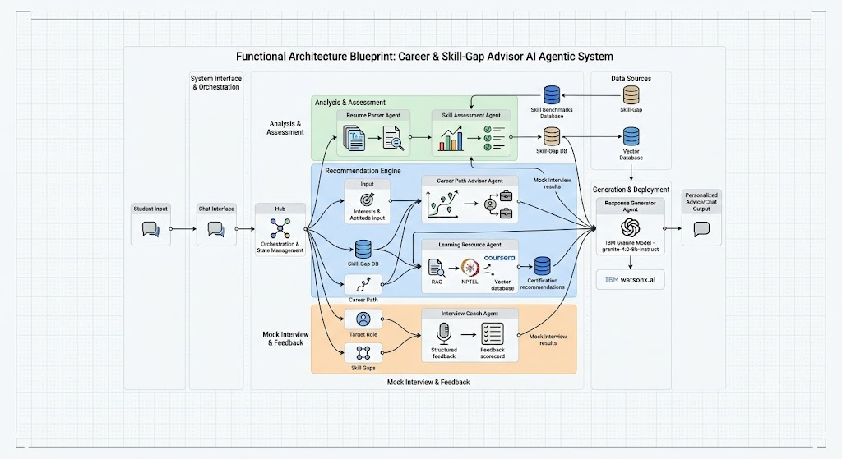
Architecture blueprint

Slide 9

Role of Agentic AI in the solution
Role of Agentic AI
Agentic AI turns this from a static resume-checker into an autonomous career mentor. Using IBM watsonx.ai and Granite models, it coordinates specialized agents — assessment, career-path, learning-resource, and interview-coach — that each own a specific task while collaborating toward one goal: closing a student's skill gap.
The system is context-aware (academic background, interests, target role) and adapts in real time as the student completes courses or retakes mock interviews. Agents share context with each other (e.g., the Interview Coach uses gaps identified by the Skill Assessment Agent), producing more coherent, personalized guidance than a single chatbot could — acting as a proactive digital career counselor available to every student, not just those who can get a placement-cell slot.

Slide 10
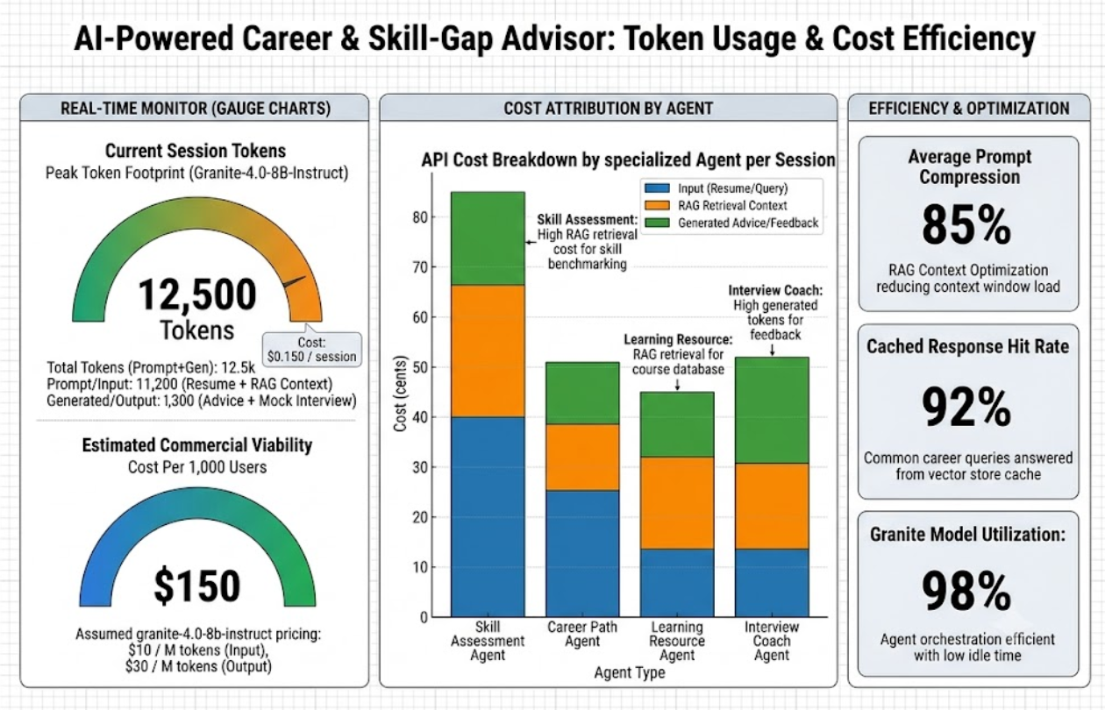
Token Usage
·
·
·

Slide 11
Novelty and Uniqueness
Multi-Agent Intelligence – Specialized agents collaborate instead of one generic chatbot
RAG-Based Accuracy – Recommendations grounded in real, current job/skill data, not stale advice
Hyper-Personalization – Tailored to academic background, interests, and target roles
Closed Feedback Loop – Mock interview performance feeds back into skill-gap recommendations
Scalable & Enterprise-Ready – Built on watsonx.ai + Granite for reliability and governance
Democratizes Access – Brings placement-cell-quality guidance to tier-2/3 colleges without added counseling staff

Slide 12
Git Hub Link
https://github.com/Lakshitha0306/AI-Powered-Career-Skill-Gap-Advisor
·
·
·

Slide 13
Future Scope
Integration with Job Portals/LinkedIn API – Live job postings to keep skill-gap analysis current and enable direct application tracking
Regional Language & Voice Support – Multilingual, voice-enabled interaction to reach students more comfortable in regional languages, widening accessibility across India
·
·
·

Slide 14
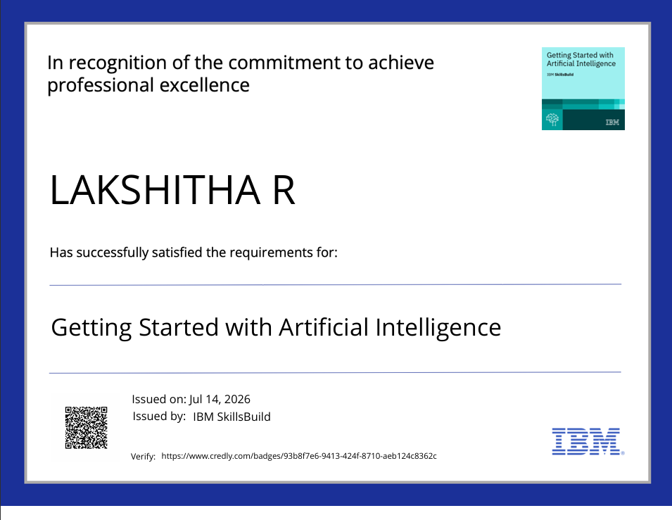
Certificates Earned:

Slide 15
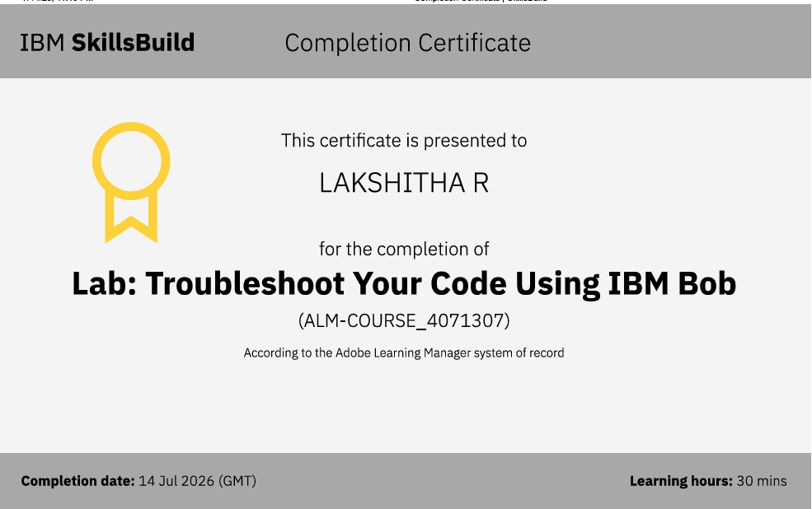
Certificates Earned:​

Slide 16


